Slide 1
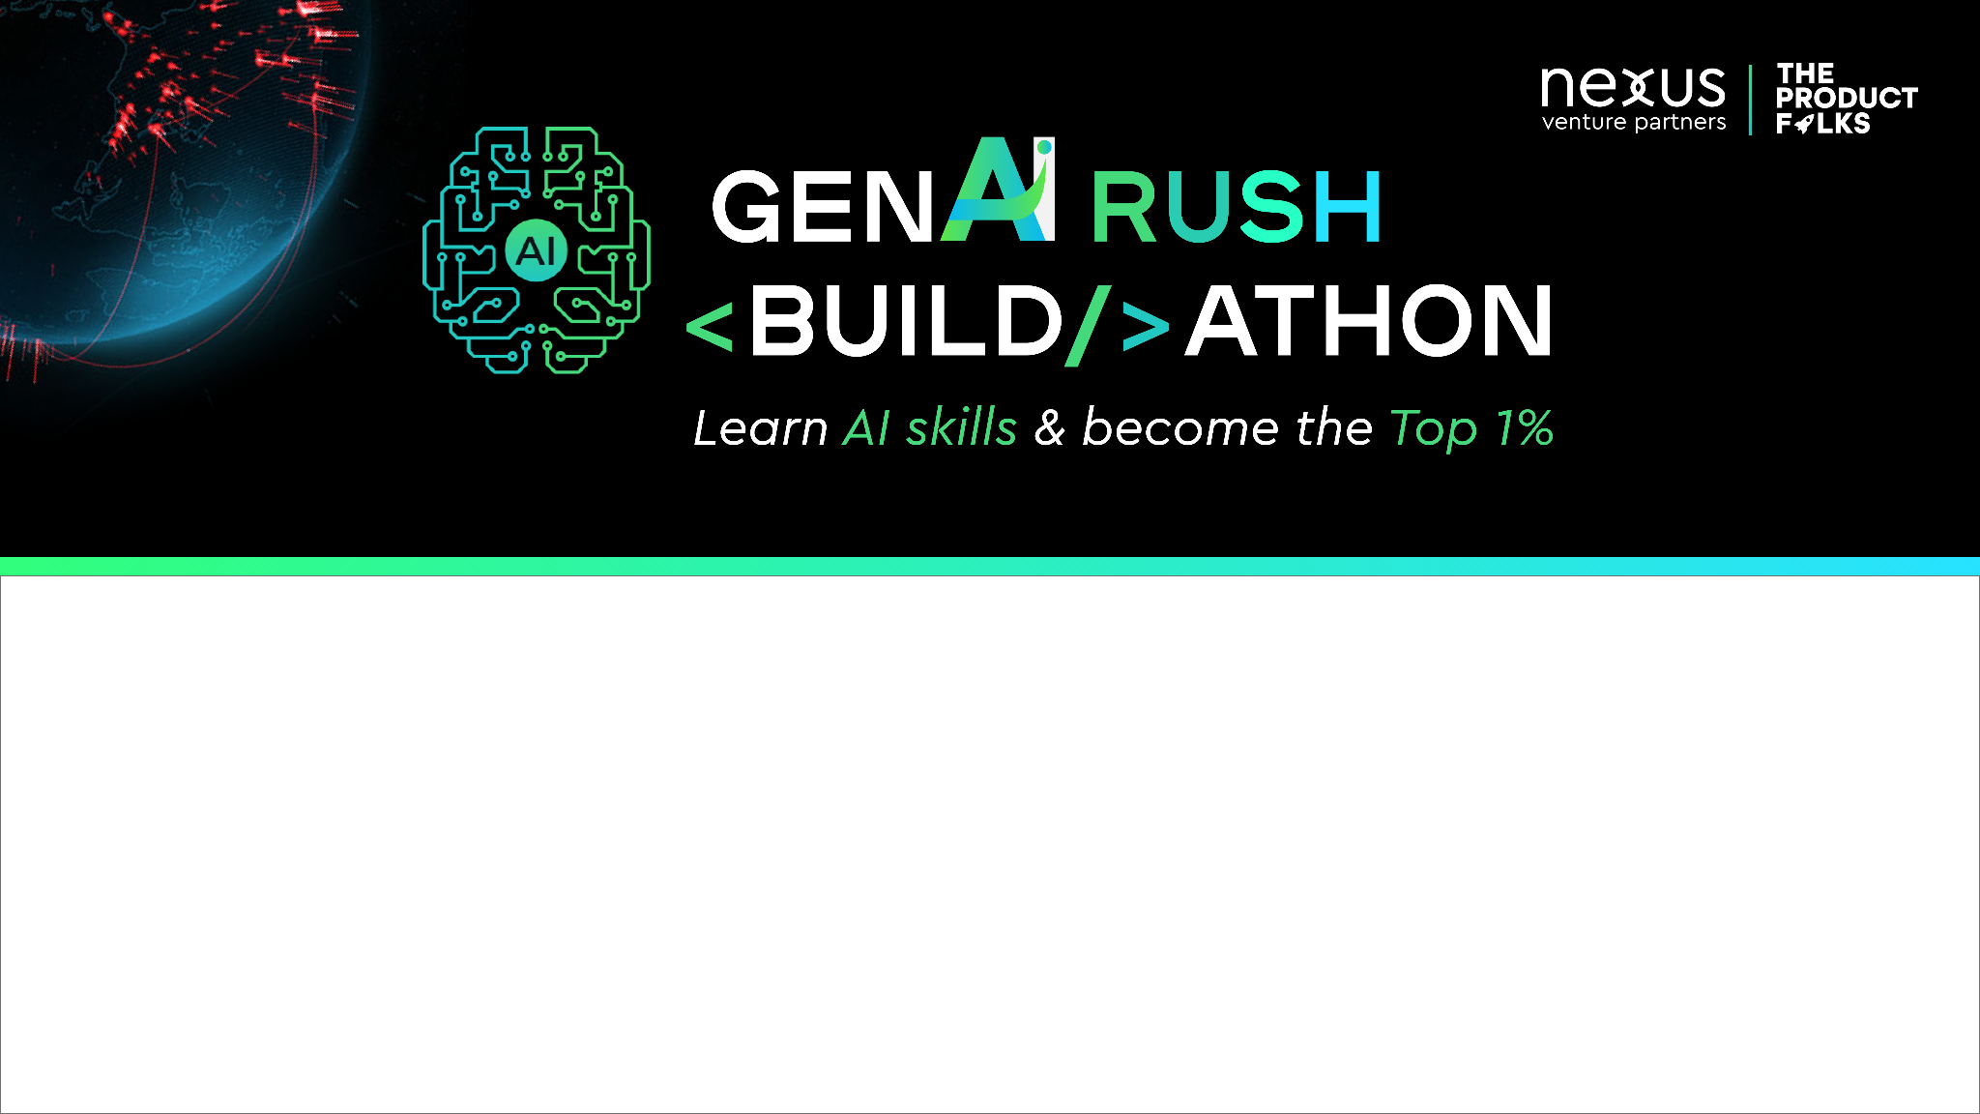

Team Name : TEAM PRISM
Problem Statement : AI-driven medical image processing with AI -Integrated Medical Diagnostic Assistant platform

Slide 2

INSIGHTS
AI-driven medical image processing is a field that holds immense potential for revolutionizing healthcare and improving patient outcomes.
It involves using artificial intelligence and advanced image processing techniques to analyze and interpret medical images, assisting healthcare professionals in diagnosis, treatment planning, and medical research.
By combining cutting-edge AI technologies with a focus on privacy, transparency, and collaboration, it has the potential to revolutionize medical report analysis, positively impacting patient care and medical decision-making.
AI-driven medical image processing holds the promise of accelerating diagnosis, improving treatment planning, and advancing medical research.
Collaboration between AI experts, radiologists, pathologists, and medical professionals is essential to develop robust and clinically validated AI solutions for widespread adoption in healthcare settings.

Slide 3
Opportunity
Advanced NLP Techniques
Transfer Learning for Image Recognition
Multimodal Fusion for Enhanced Diagnosis
Uncertainty Estimation
Explainable AI (XAI)
Continual Learning and Active Learning
Edge Computing and Privacy-Preserving AI
Clinical Validation and Regulatory Compliance
Collaboration with Medical Experts and Institutions

Slide 4
List of features offered by the solution :
Automated Disease Detection: Developing AI algorithms that can automatically detect and localize abnormalities and diseases in medical images, such as tumors in MRI or CT scans, assisting radiologists in early and accurate diagnoses.
Segmentation and Feature Extraction : Using AI-based image segmentation techniques to delineate organs, tissues, or lesions in medical images, enabling precise measurement and quantification of relevant features for diagnosis and treatment planning.
Multi-Modal Fusion: Creating AI models that integrate information from multiple imaging modalities, such as MRI, CT, and PET scans, to provide comprehensive insights into complex medical conditions.
Real-Time Image Enhancement: Implementing AI-based image enhancement techniques that improve the quality of medical images, reducing noise, artifacts, and improving visualization for better interpretation.
Super-Resolution Imaging: Using AI-driven super-resolution algorithms to enhance the resolution and quality of medical images, aiding in the visualization of fine structures and improving diagnostic accuracy.
Image Registration and Alignment: Developing AI algorithms for image registration and alignment, allowing the integration of multiple images from different time points or imaging modalities for disease progression monitoring.
Quantitative Image Analysis: Utilizing AI-based image analysis to quantify biomarkers, such as tumor size, volume, or density, providing objective and standardized measurements for research and clinical trials.

Slide 5
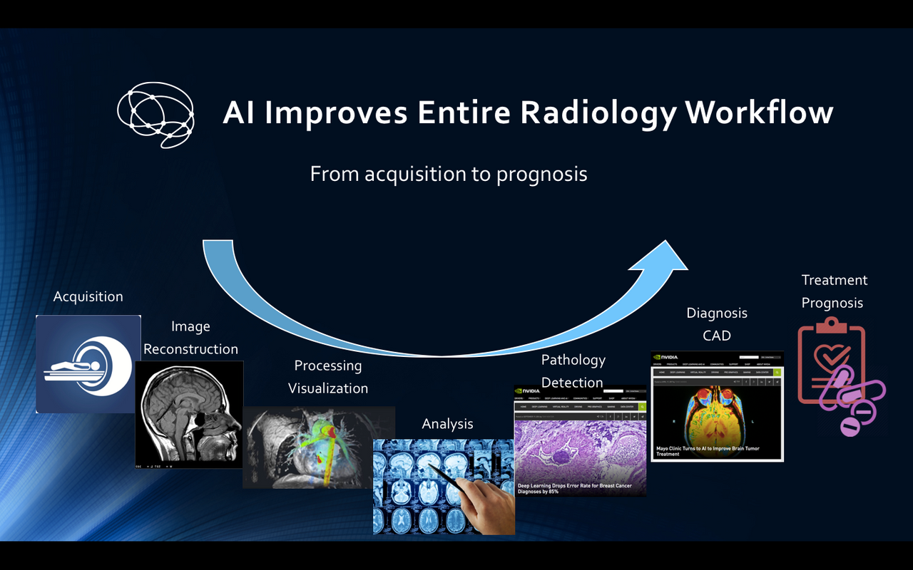

Slide 6
Radiomics and AI Radio genomics: Combining radiomics (extracting quantitative features from medical images) with AI algorithms to correlate imaging features with genomics data, facilitating precision medicine and personalized treatment approaches.
AI in Pathology Imaging: Applying AI to analyse histopathological images, assisting pathologists in detecting abnormalities and predicting disease prognosis.
AI-Enhanced Image Interpretation: Creating AI systems that assist radiologists in image interpretation, providing relevant clinical context, and suggesting possible diagnoses to support medical decision-making.
AI-Guided Surgical Navigation: Developing AI-driven surgical navigation systems that overlay medical images onto the surgical field, aiding surgeons in precise localization and real-time guidance during procedures.
AI for Neuroimaging and Brain Mapping: Applying AI algorithms to analyse brain MRI and fMRI data, facilitating brain mapping, identifying neurological conditions, and advancing research on brain function and disorders.
Virtual Biopsies: Utilizing AI to create virtual biopsies from medical images, enabling non-invasive analysis of tissue structures and aiding in treatment planning.
AI for Remote Diagnosis and Telemedicine: Implementing AI-driven image analysis in telemedicine platforms to facilitate remote diagnosis and provide healthcare access in underserved areas.
Automated Quality Control: Using AI to automate quality control processes for medical images, ensuring consistency and accuracy in image acquisition and analysis.

Slide 7
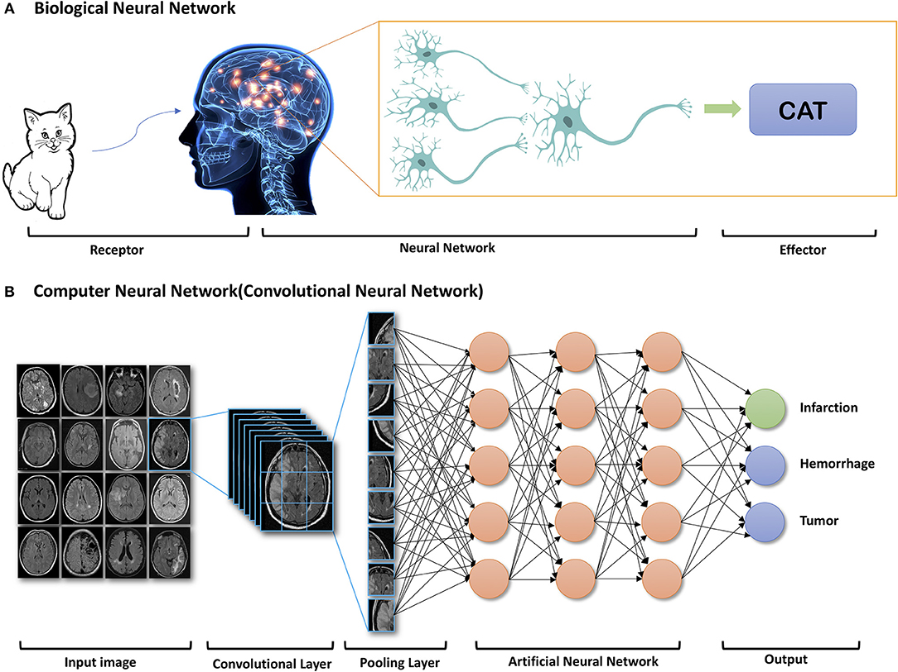
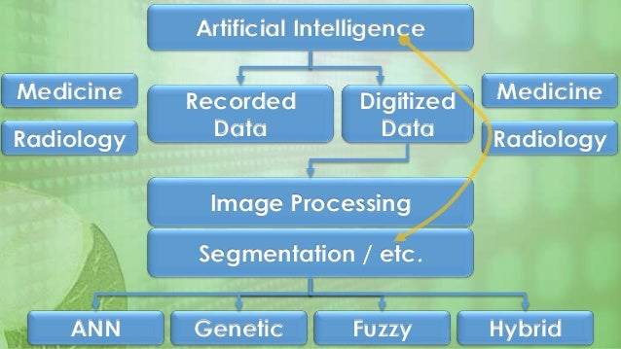
Process Flow Diagram / Use case Diagram:

Slide 8
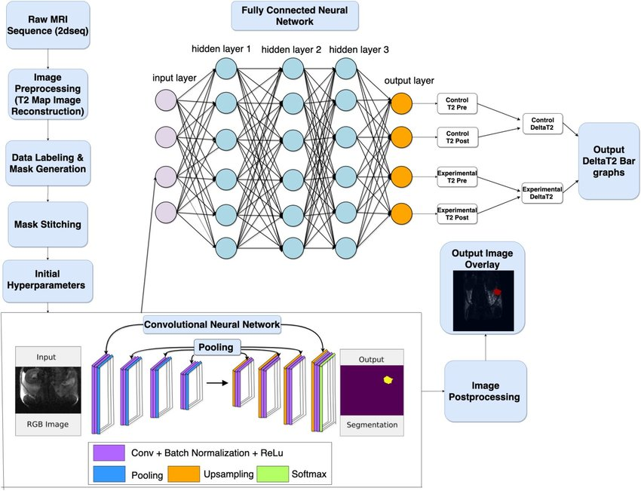

Slide 9
The business profit potential for AI-driven medical image processing can be significant, given the transformative impact it can have on healthcare outcomes. However, several factors influence the profit generation in this domain:
Market Demand: The demand for AI-driven medical image processing solutions is influenced by the increasing need for accurate and timely diagnosis, improved treatment planning, and medical research advancements. Healthcare facilities that prioritize efficiency and better patient care are more likely to invest in AI solutions.
Product Differentiation: Companies offering unique and highly effective AI algorithms with superior accuracy and efficiency will have a competitive advantage. Innovations that solve specific challenges in medical image analysis and cater to diverse medical imaging modalities can command higher profits.
Clinical Validation and Regulatory Compliance: Clinically validated AI solutions that comply with relevant healthcare regulations gain trust and confidence from healthcare providers. Validation studies demonstrating improved patient outcomes and cost-effectiveness can justify premium pricing.
Market Penetration: Widespread adoption of AI-driven medical image processing relies on scalability and penetration into various healthcare facilities. Companies with scalable and adaptable solutions can reach a broader customer base, driving higher profit potential.
Partnerships and Collaborations : Strategic collaborations with healthcare institutions, radiology centers, and research organizations can expand the reach of AI solutions, leading to increased revenue streams and market presence.

Slide 10
Pricing Model: Choosing the right pricing model, whether it be subscription-based, per usage, or one-time licensing, can impact profit margins. Flexibility in pricing to accommodate different customer needs can attract a broader customer base.
Customer Satisfaction and Retention: High customer satisfaction and successful implementations lead to repeat business and positive referrals, contributing to long-term profitability.
Service and Support: Providing exceptional customer service and support, including training and ongoing assistance, can enhance the perceived value of AI solutions and encourage customer loyalty.
Intellectual Property Protection: Companies that hold proprietary AI algorithms and technologies can protect their innovations through patents and licensing agreements, allowing them to monetize their intellectual property.
Continuous Innovation: Investing in research and development to continuously improve and innovate AI algorithms can maintain a competitive edge and drive long-term growth and profitability.

Slide 11
Technology used : AI ,CNN, Camera, cloud storage, Python library and frameworks , SimpleITK, PyDICOM, Web/mobile app development library.
Estimated cost of/after implementing the solution :
The potential benefits and cost savings resulting from the implementation of the medical image processing solution, such as improved diagnostic accuracy, streamlined workflows, and better patient outcomes, should be taken into account when evaluating the return on investment (ROI). Additionally, collaboration with healthcare partners and strategic partnerships may help share the cost burden and expand the solution's adoption.
Initial Investment for developing is just the Web/Mobile application, use python libraries and frameworks Cloud storage, scanners and cameras.
Estimated to ₹ 15,000

Slide 12


